Slide 1
Status of ATLAS commissioning
IPRD08 - 11th Topical Seminar on Innovative Particle and Radiation Detectors
1 - 4 October 2008 Siena, Italy
Sandro Palestini, CERN
for the ATLAS Collaboration

Slide 2
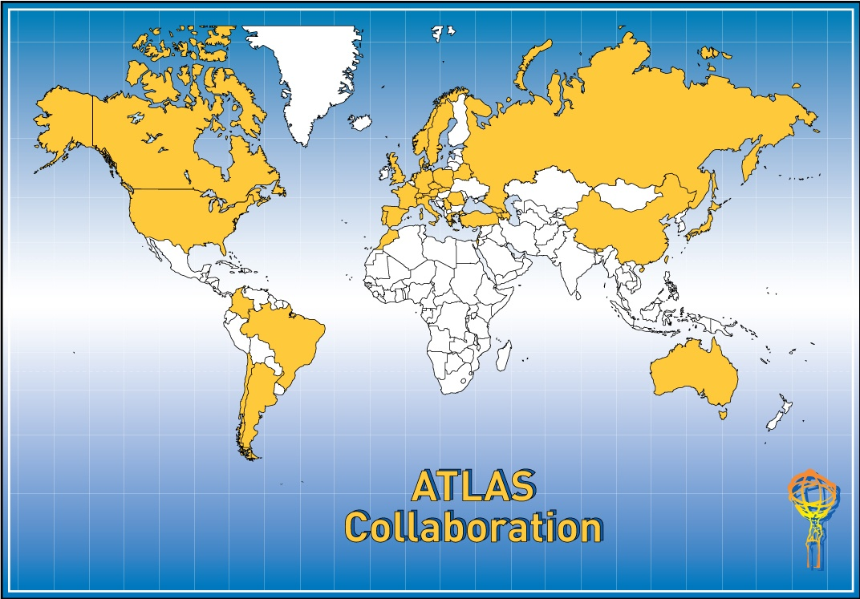
Talk presented
on behalf of the
ATLAS Collaboration
37 Countries
169 Institutions
2500 Scientific Authors total
Albany, Alberta, NIKHEF Amsterdam, Ankara, LAPP Annecy, Argonne NL, Arizona, UT Arlington, Athens, NTU Athens,
Baku, IFAE Barcelona, Belgrade, Bergen, Berkeley LBL and UC, HU Berlin, Bern, Birmingham, UAN Bogota, Bologna, Bonn, Boston, Brandeis, Bratislava/SAS Kosice, Brookhaven NL, Buenos Aires, Bucharest, Cambridge, Carleton, Casablanca/Rabat, CERN, Chinese Cluster,
Chicago, Chile,Clermont-Ferrand, Columbia, NBI Copenhagen, Cosenza, AGH UST Cracow, IFJ PAN Cracow,
UT Dallas, DESY, Dortmund, TU Dresden, JINR Dubna, Duke, Frascati, Freiburg, Geneva, Genoa, Giessen, Glasgow, Göttingen, LPSC Grenoble,
Technion Haifa, Hampton, Harvard, Heidelberg, Hiroshima, Hiroshima IT, Indiana, Innsbruck, Iowa SU, Irvine UC, Istanbul Bogazici,
KEK, Kobe, Kyoto, Kyoto UE, Lancaster, UN La Plata, Lecce, Lisbon LIP, Liverpool, Ljubljana, QMW London, RHBNC London, UC London, Lund,
UA Madrid, Mainz, Manchester, CPPM Marseille, Massachusetts, MIT, Melbourne, Michigan, Michigan SU, Milano, Minsk NAS, Minsk NCPHEP, Montreal, McGill Montreal, FIAN Moscow, ITEP Moscow, MEPhI Moscow, MSU Moscow, Munich LMU, MPI Munich,
Nagasaki IAS, Nagoya, Naples, New Mexico, New York, Nijmegen, BINP Novosibirsk, Ohio SU, Okayama, Oklahoma, Oklahoma SU, Olomouc, Oregon, LAL Orsay, Osaka, Oslo, Oxford,Paris VI and VII, Pavia, Pennsylvania, Pisa, Pittsburgh, CAS Prague, CU Prague, TU Prague, IHEP Protvino,
Regina, Ritsumeikan, UFRJ Rio de Janeiro, Rome I, Rome II, Rome III, Rutherford Appleton Laboratory, DAPNIA Saclay, Santa Cruz UC, Sheffield, Shinshu, Siegen, Simon Fraser Burnaby, SLAC, Southern Methodist Dallas, NPI Petersburg, Stockholm, KTH Stockholm, Stony Brook, Sydney,
AS Taipei, Tbilisi, Tel Aviv, Thessaloniki, Tokyo ICEPP, Tokyo MU, Toronto, TRIUMF, Tsukuba, Tufts, Udine/ICTP, Uppsala, Urbana UI,
Valencia, UBC Vancouver, Victoria, Washington, Weizmann Rehovot, FH Wiener Neustadt, Wisconsin, Wuppertal, Würzburg, Yale, Yerevan
15-April-2008 ATLAS RRB
2

Slide 3
Outline
Last phases of detector installation
Tests of full magnet system
Detector commissioning
Combined cosmic runs
DAQ/data flow
Commissioning of computing model
Preparation of physics studies
Experience with first beams on Sept. 10

Slide 4

The ATLAS detector
45 m
24 m
7000 T
Ref.: “The ATLAS Experiment at the CERN LHC”, 2008 JINST 3 S08003 (http://www.iop.org/EJ/toc/1748-0221/3/08)

Slide 5
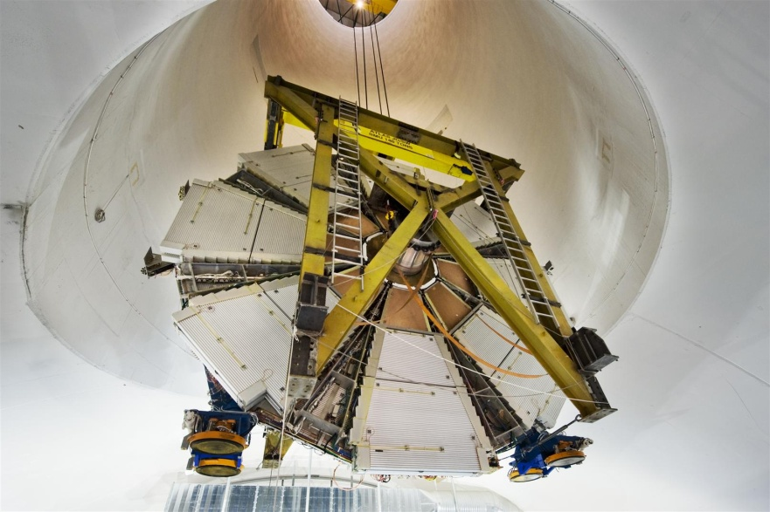
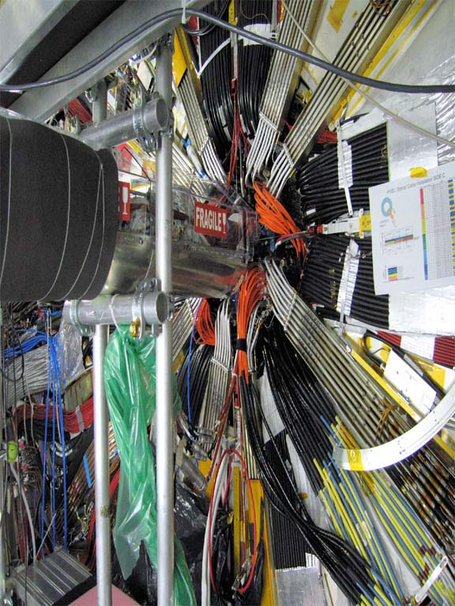
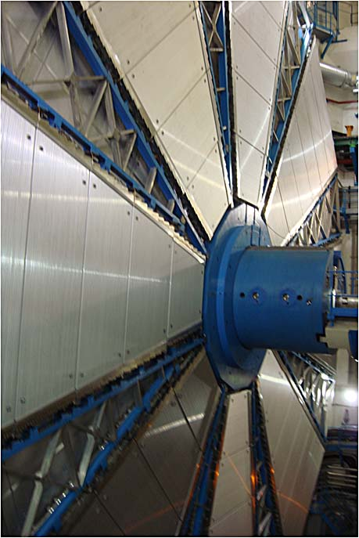
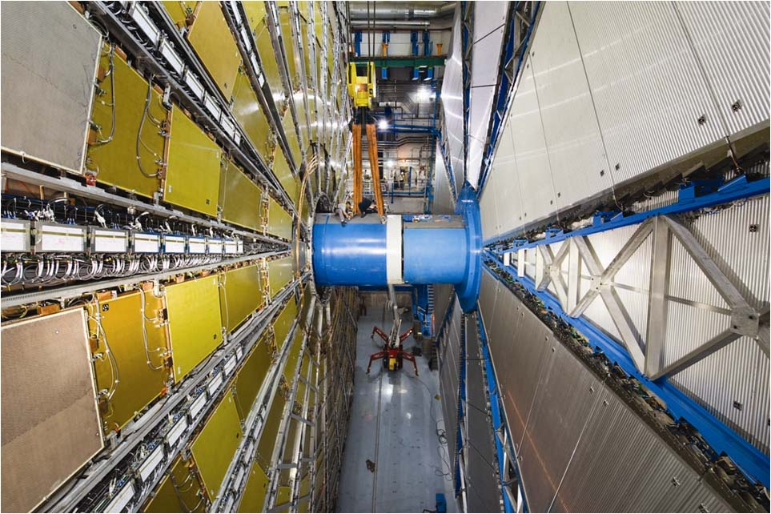
Installation of the last components
Installation of Small Wheels of Muon End-Cap in Feb-Mar 08
Cabling of Pixel detector in spring 08
Completion of outer station of Muon End-Cap in June 08
LHC beam-pipe closed in June 08

Slide 6
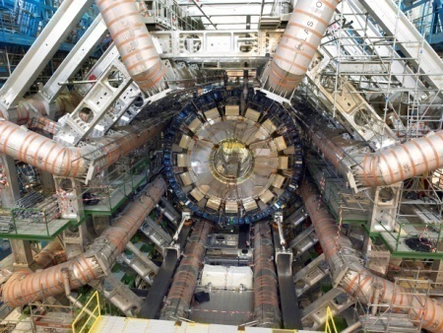
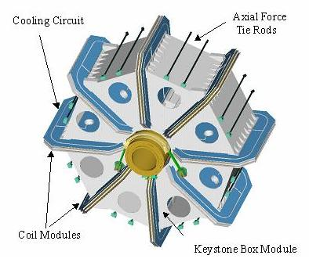
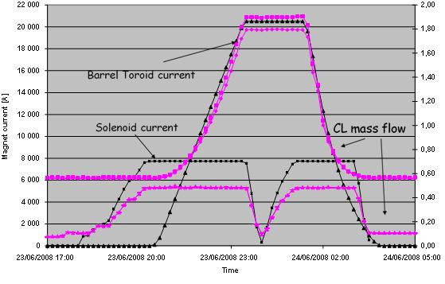
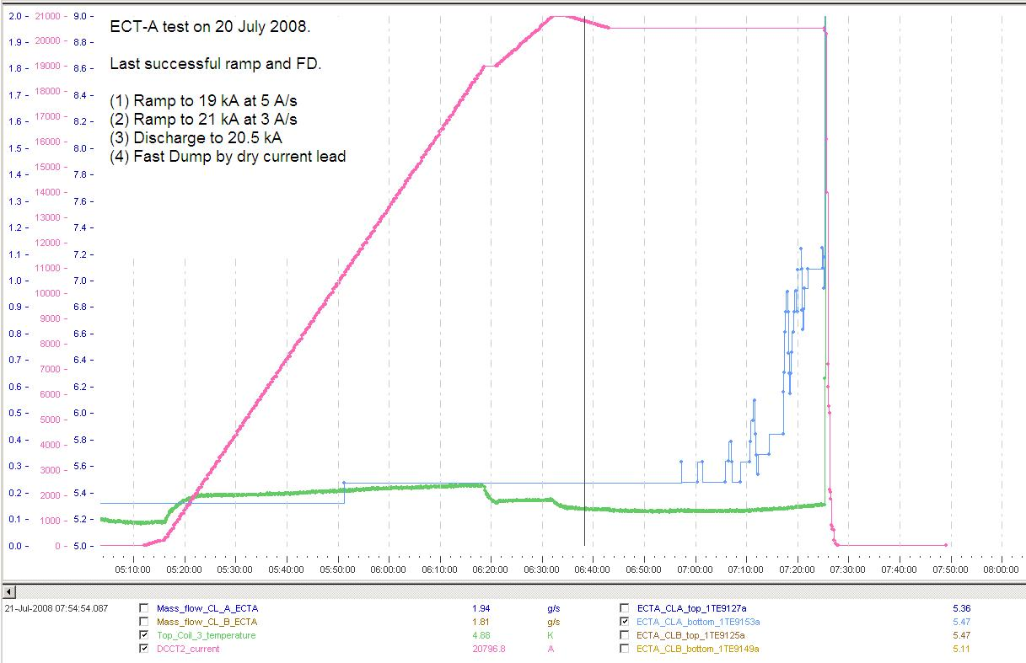
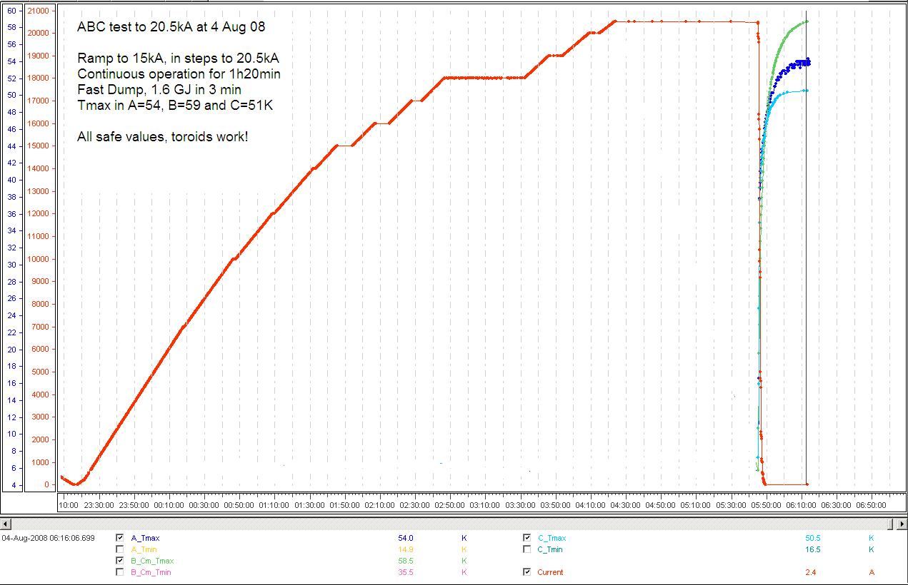
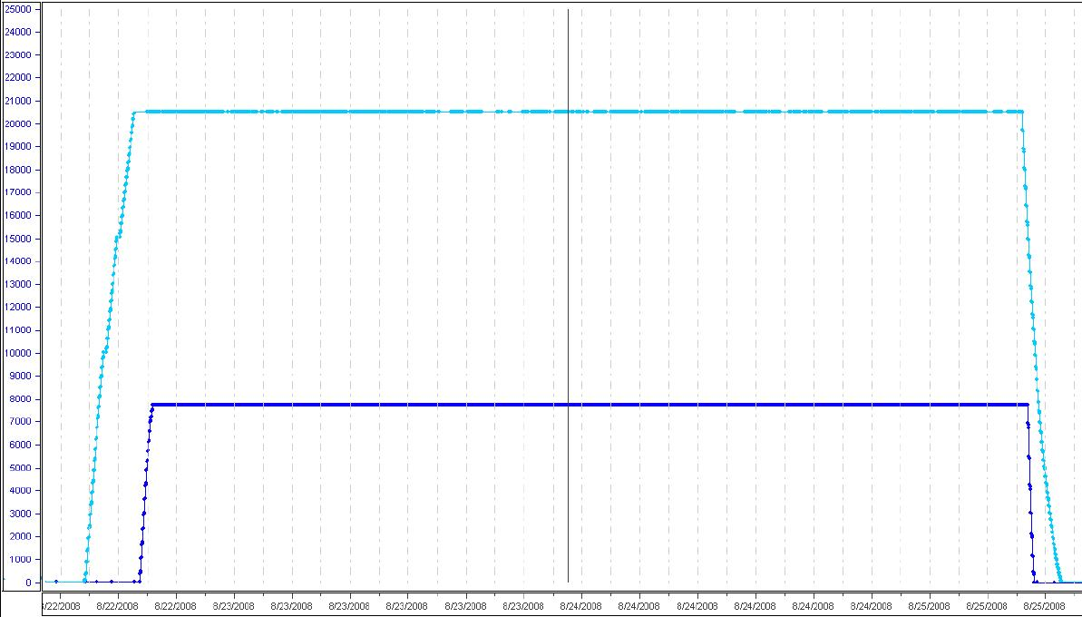
Test of the full magnet system
Test of Barrel Toroid and Solenoid on July 23-24
Test of End-Cap Toroid side A on July 20 (after leak repair)
All magnets (4) tested together tested together repeatedly from on Aug 22
Test of all (3) Toroids together on Aug 4
20.5 / 7.63 kA

Slide 7
Detector commissioning
The commissioning of the detector started in 2006 with the first Milestone Run and Technical Runs:
  Operate together the various subsystems (with local and central Detector Control System), verify stability of hardware
  Develop and test data monitoring
  Check channel mapping, noise, timing
  Integrate into DAQ
  Commission and operate trigger systems (cosmic rays)
  Develop and test calibration procedures
  Acquire and process data, make first test of track-based calibration and alignment

Slide 8
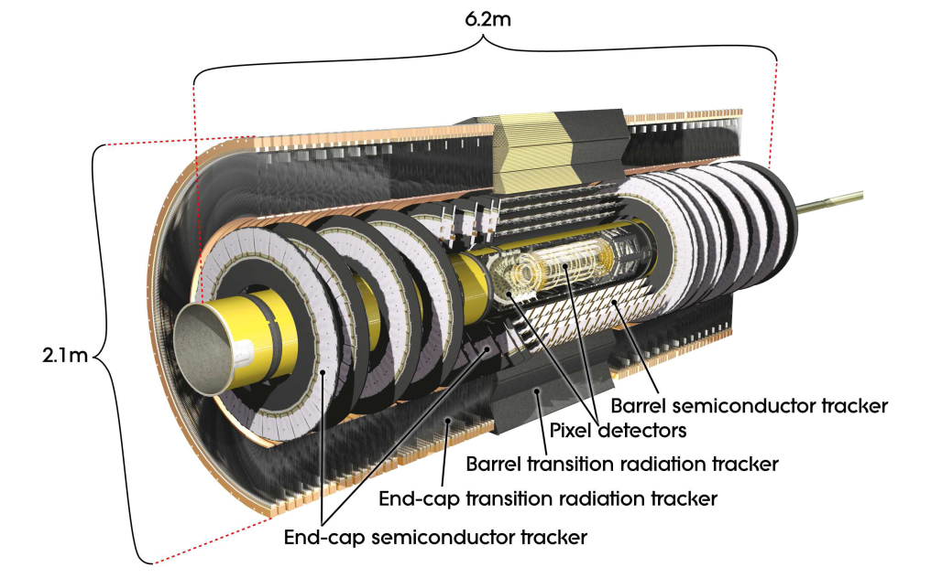
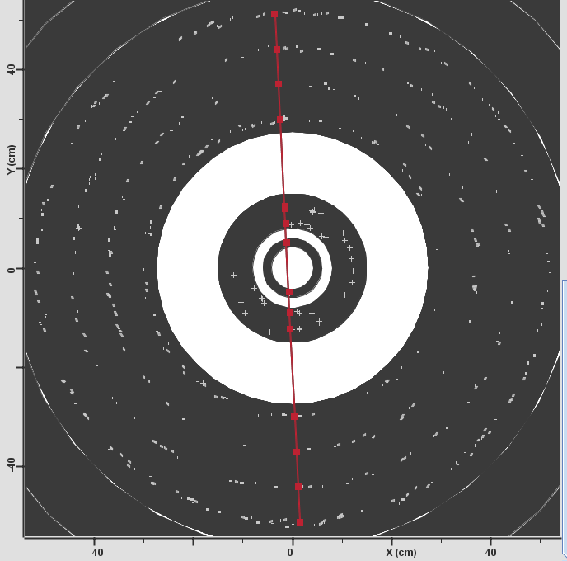
Inner Detector
Status of commissioning:
Pixel delayed by difficulties with cooling, could only start in August after beam-pipe bake-out
Currently 94 % of the module are active
Cosmic ray tracks have been detected together with SCT from mid-September.
Design and goals:
Si pixels, Si strips , straw tubes, |η|<2.5 (<2 TRT)
  Pixel: 80 M channels, 3 layers
  SCT: 8 layers, stereo pairs, 6.3 M ch.
  TRT: 350 k ch., typically 36 hits/track, transition radiation (e/π: 0.5-150 GeV)
Operate in 2 T solenoid field
σ p_{T} /p_{T} ∼ 0.05% p_{T} ⊕ 1%
6+1 points in Pixel, 8 points in SCT

Slide 9
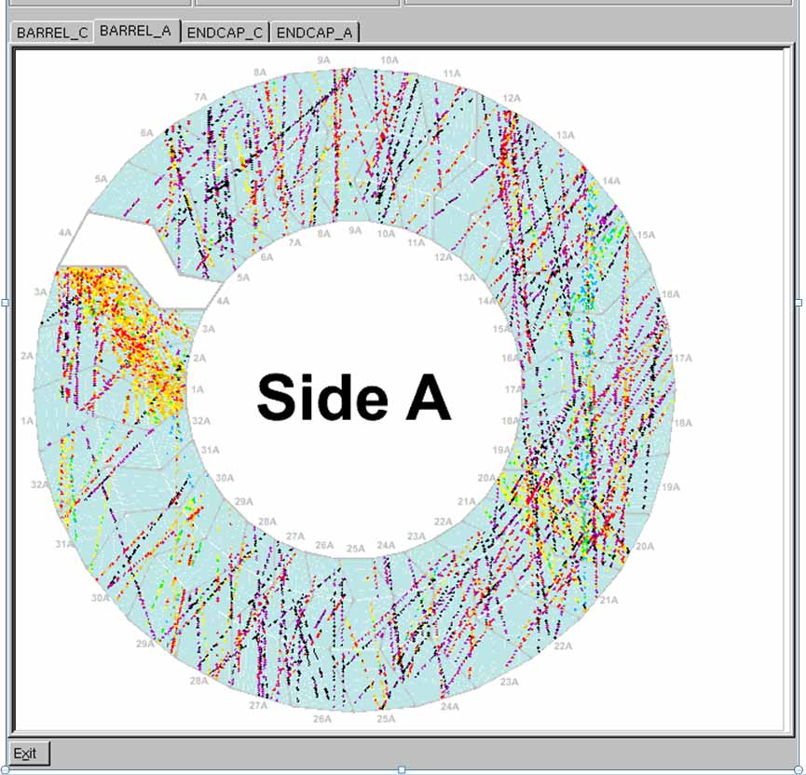
TRT commissioning
Hit map (many events) in TRT/barrel , projected to z = 0, from cosmic-ray run in June 08.
Color maps different track time (within ± 35 ns, due different triggering devices).

Slide 10
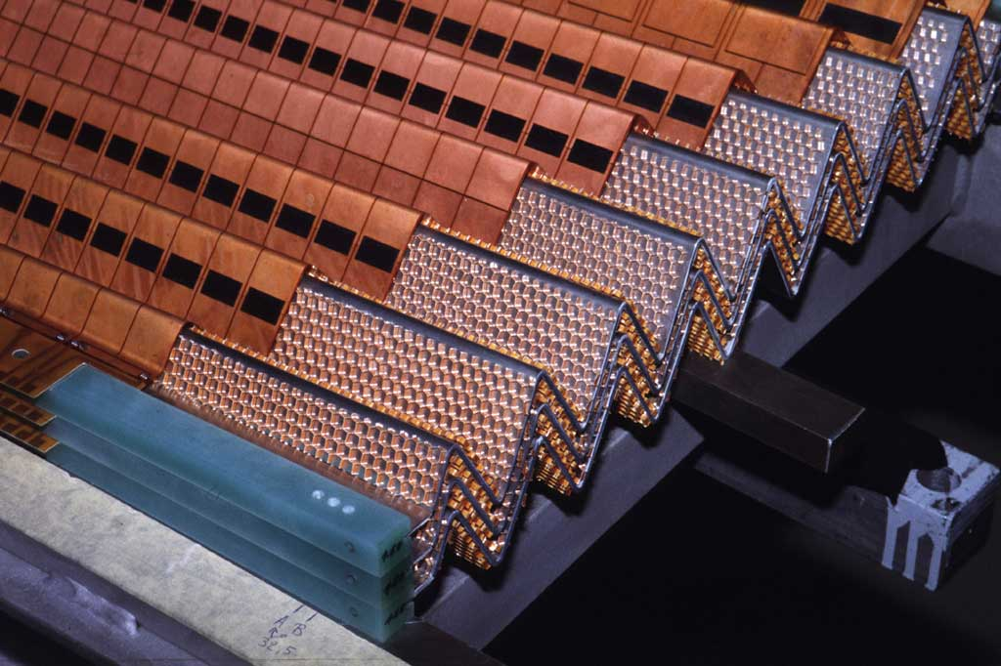
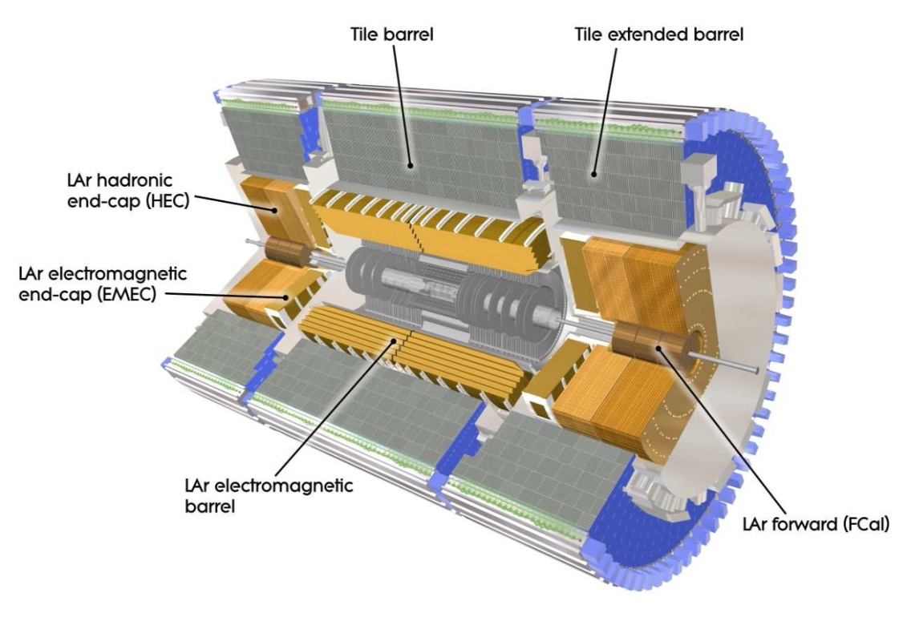
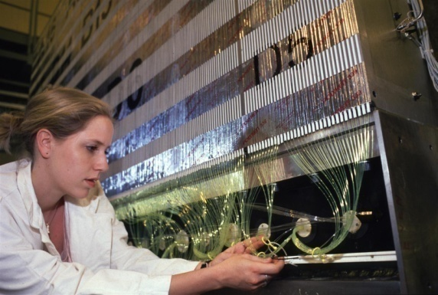
Calorimeters
Design:
“Barrel” calorimeters
Electromagnetic: |η|<3.2
  Lead-liquid argon, 3 sampling depths in precision region |η|<2.5; Presampler |η|<1.8
  ~175k channels
Hadronic:
  Barrel: steel-scintillating tiles |η|<1.7,
  3 sampling depths, 10k channels
Endcap: 1.5<|η|<3.2,
  copper-liquid Ar, 4 sampling depths, 6k channels
Forward: 3.1<|η|<4.9
  (1 Copper+2 tungsten)-liquid Ar depths for e.m. and hadronic measurements, 3.5k channels
Goals:
precision measurements of e/γ for |η|<2.5
  σ/E ~ 10%/√E ⊕ 0.7%
  Linearity to ~0.1%
Coarser granularity in the forward region
Total energy resolution for Jet and E_{T}^{miss} measurements
  σ/E ~ 50%/√E ⊕ 3% (barrel/endcap)
  σ/E ~ 100%/√E ⊕ 10% (forward)

Slide 11
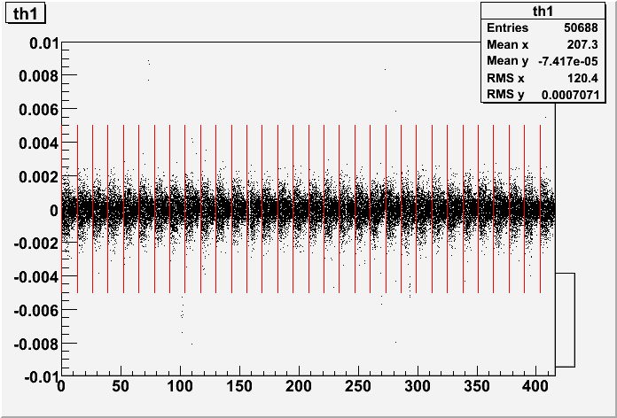
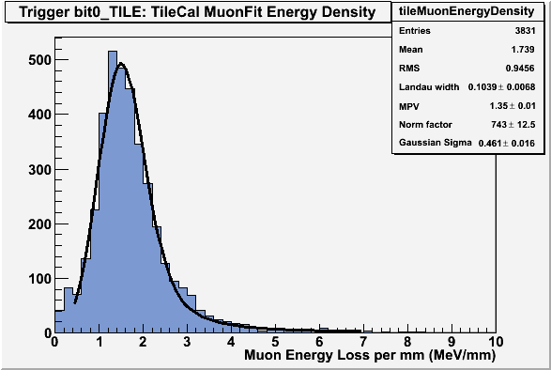
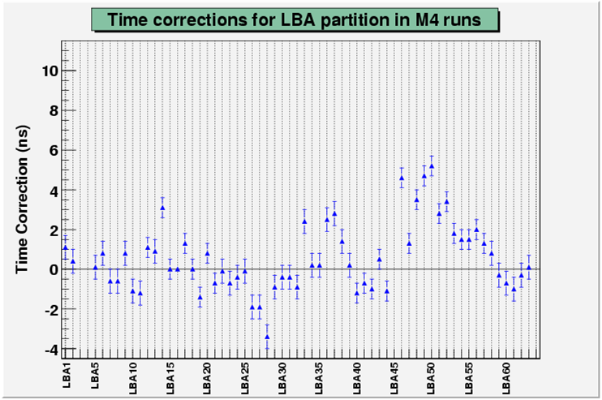
Calorimeters commissioning
Muon in LAr
Muons in calorimeters: energy scale and uniformity verified at ∼2 %
Stability LAr Barrel side A:
Difference of amplitude between two calibration runs taken one week apart vs. channel number (14*32 FEB - 128 channels each)
LAr dead/noisy channels:
  Dead channels:
    EMB: 0.5%, EMEC: 0.2%, HEC (15%), FCAL (0%)
  Noisy channels:
    > 10σ w.r.t. φ average: 0.003%
    Between 5σ and 10σ: 0.09%
  Uncalibrated or badly calibrated channels: 0.3 / 0.2 %
  Most problems recoverable during a shutdown (exchange of FEB)
Tile muon cosmics
Tile timing corrections: μ triggered by RPC’s

Slide 12
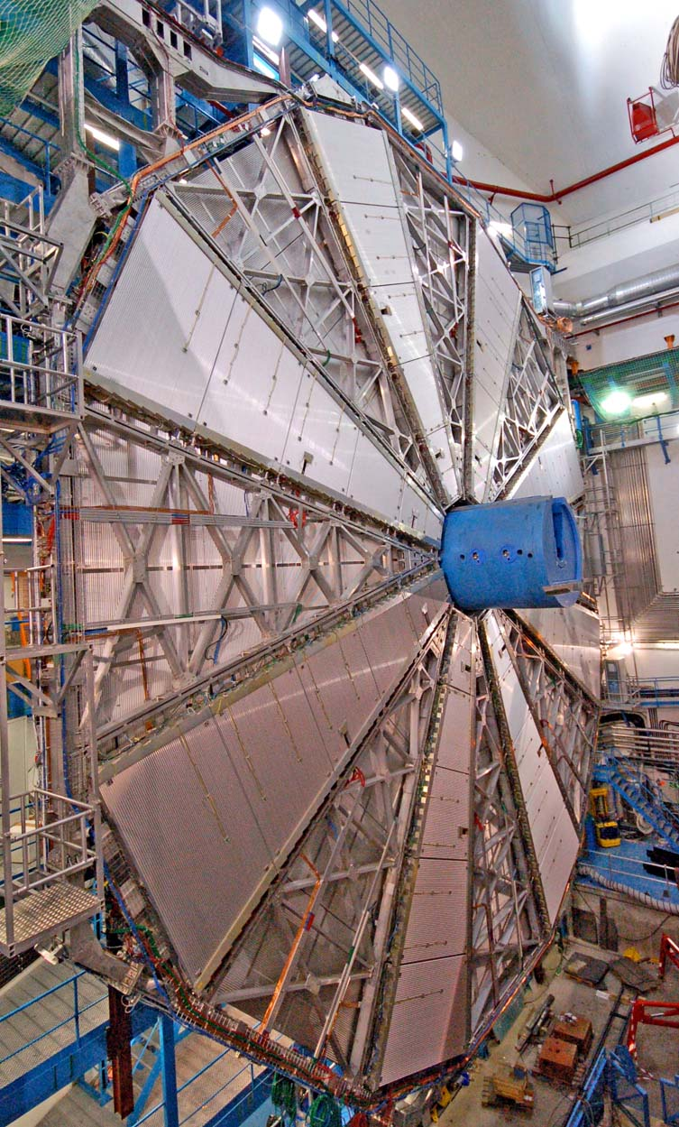
Muon Spectrometer
Air-core toroid magnet system
Barrel: ~1.5-5.5 Tm in 0<|η|<1.4
Endcaps: ~1-7.5 Tm in 1.6<|η|<2.7
Precision tracking chambers
  Track coordinate in bending plane
  3 barrel layers, 3 end-cap wheels
  ~370k readout channels
Monitored Drift Tubes (MDT)
  |η|<2.7 (innermost layer |η|<2.0)
Cathode Strip Chambers (CSC)
  innermost layer 2.0<|η|<2.7
Trigger chambers
  Bunch-crossing ID, triggering, coordinate orthogonal to tracking measurement
  ~680k readout channels
Resistive Plate Chambers (RPC)
  |η|<1.05
  3 double layers
Thin Gap Chambers (TGC) (4+4 wheels)
  1.05<|η|<2.7 (2.4 for triggering)
MDT Big Wheel (Intermediate EndCap station) during installation

Slide 13
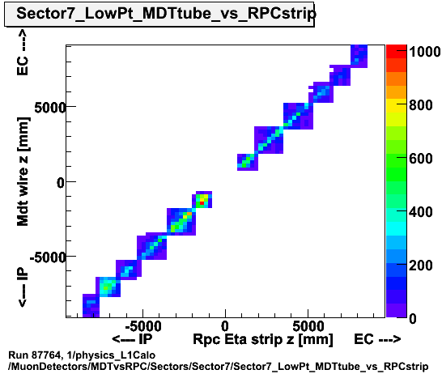
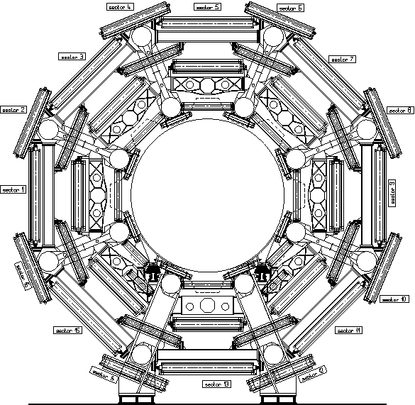
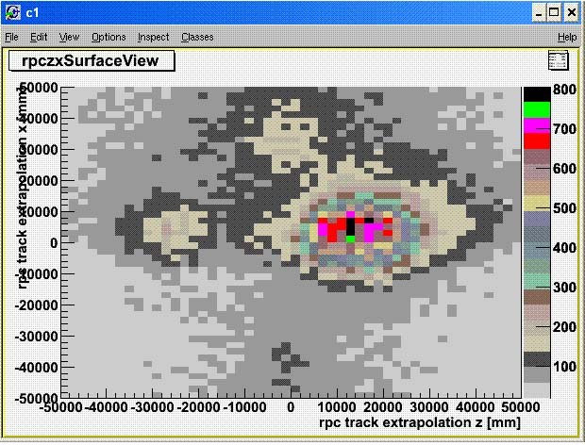
Muon spectrometer commissioning
Commissioning of RPC sectors
Correlation between MDT and RPC hits in cosmic data
track projections from RPCs
to surface
Ready
Missing timing adjustment
Noise on clock propagation
Missing CAEN boards

Slide 14
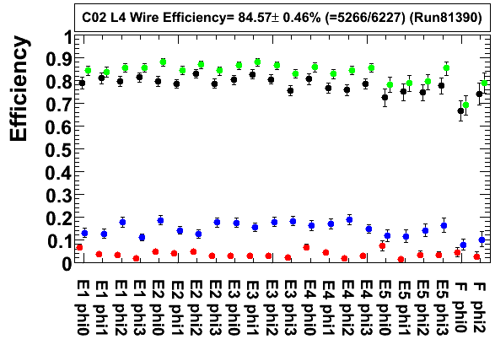
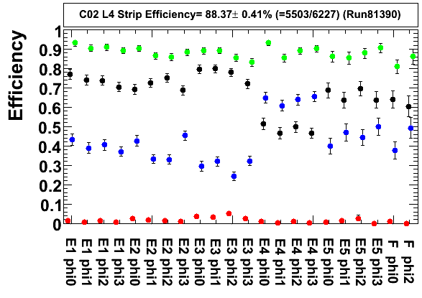
TGC chambers
Flammable gas system allowed only since July 2008: very low efficiency before that time. Studies of efficiency (and timing) started recently and are still underway.
Efficiency with hits at “current” or “next” bunch-crossing:
Red : Previous
Black : Current
Blue : Next
Green : Current or next
r

Slide 15
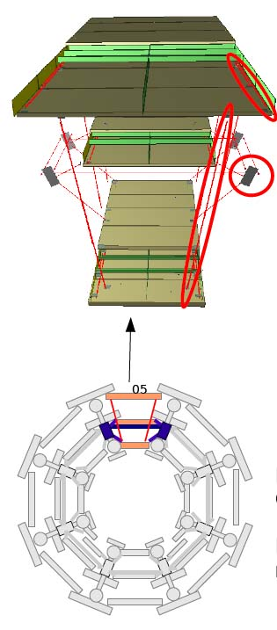
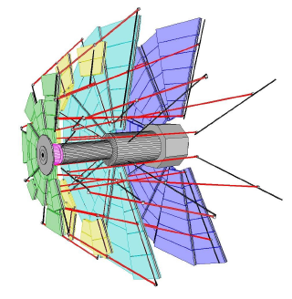
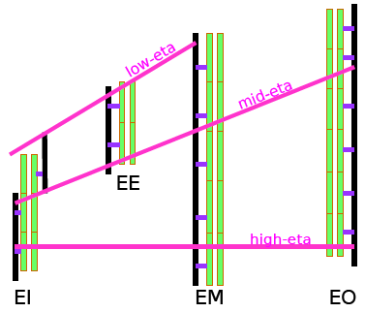
Muon alignment system
The support structures in our air-core toroid are light enough that the relative alignment of the Muon stations changes with time (e.g.: turning on/off the magnets, temperature variations – effects ∼ 0.1 – 1 mm)
Need alignment system (optical devices, calibrated and accurately positioned on chambers to determine the geometry of the spectrometer.
Barrel: limitations in positioning accuracy and calibration requires that the alignment system will be used in relative mode, referred to alignement data and tracks measured with toroids off.
EndCap: the implementation has been accurate enough so that the geometry of the spectro-meter can be achieved from the alignment system alone (absolute mode) with precision as good as ∼ 40 μm in the bending plane.

Slide 16
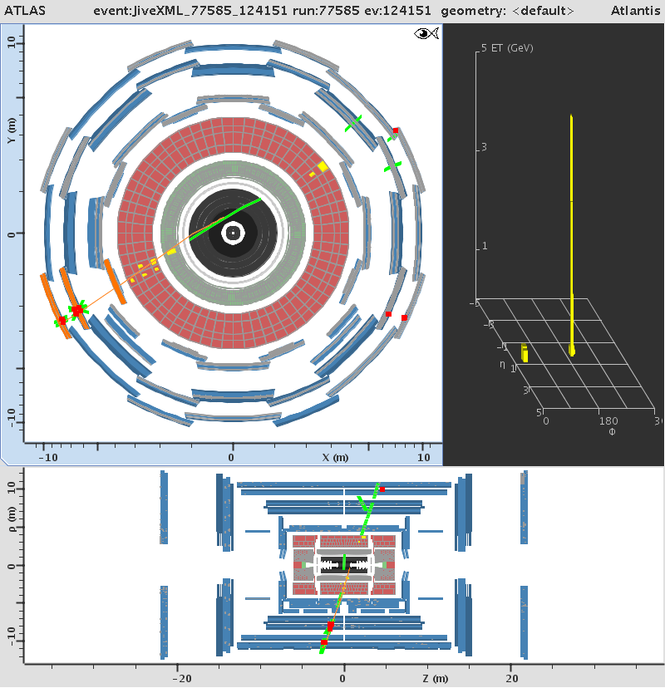
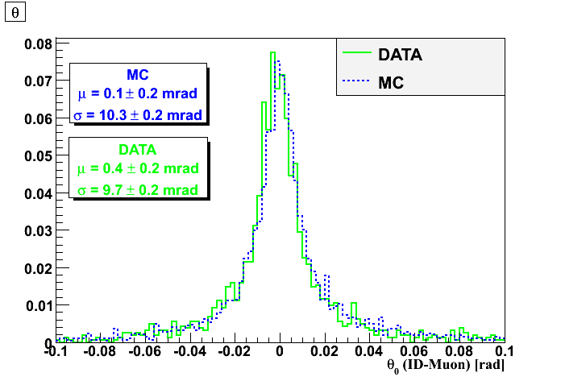
Combined cosmic runs
θ_{ID}-θ_{MS} (rad)
LAr
Tile
Muon

Slide 17
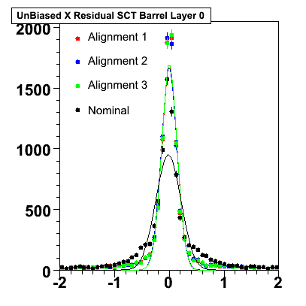
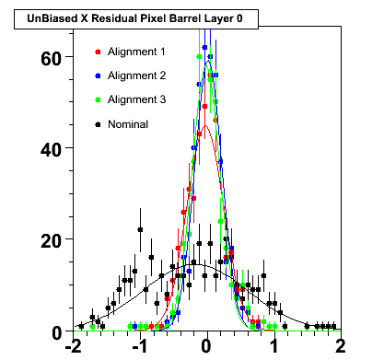
First attempts of alignment in Inner Detector
Small samples of cosmics, no B-field, no vertex cut, alignment of layers and not single modules yet, units in mm
SCT alignment with small sample of cosmics, only layer-to-layer alignment
Pixel to SCT/Pixel alignment (layer-to-layer)

Slide 18
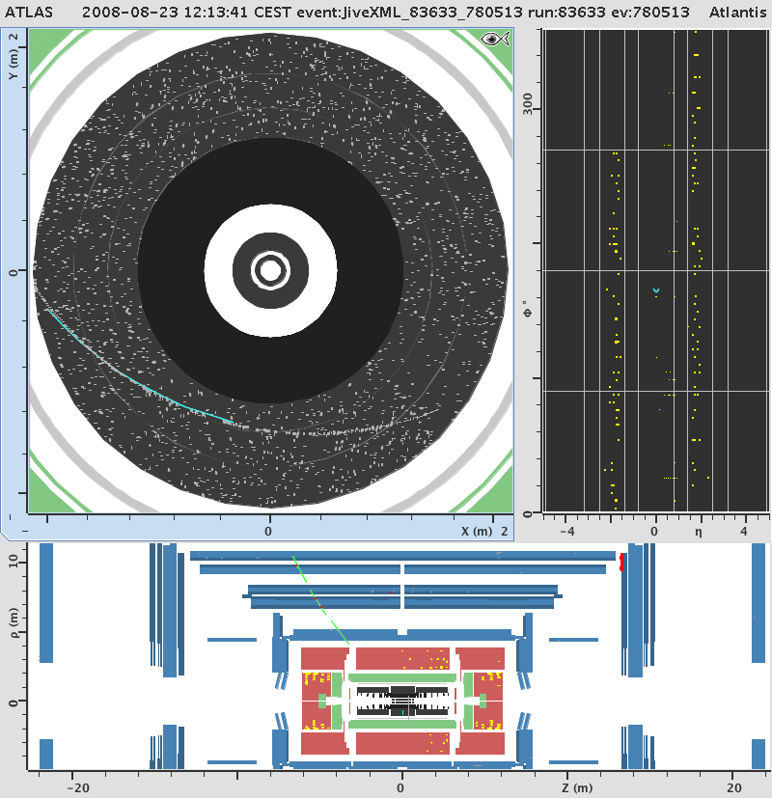
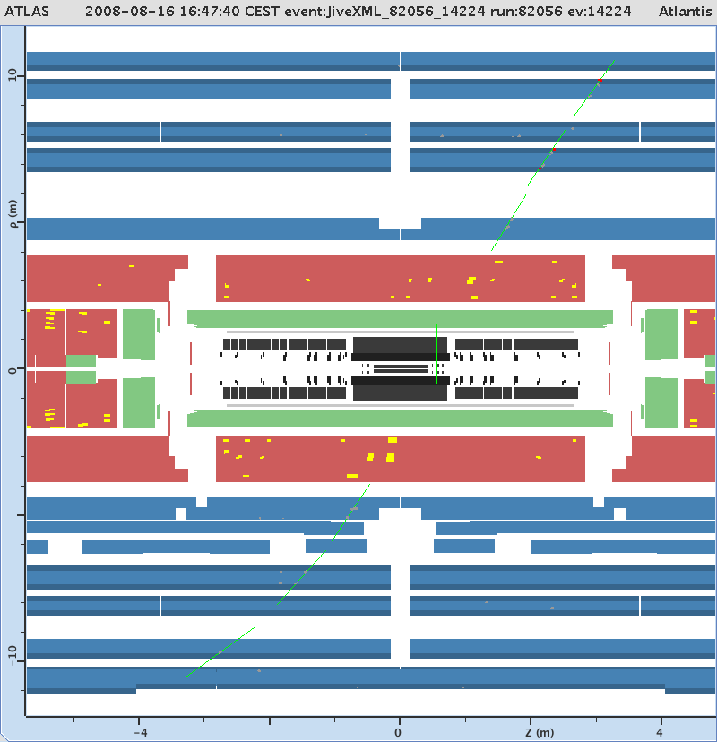
Cosmic events taken with magnets on
And even something like this
(TRT/barrel projected to z=0):

Slide 19
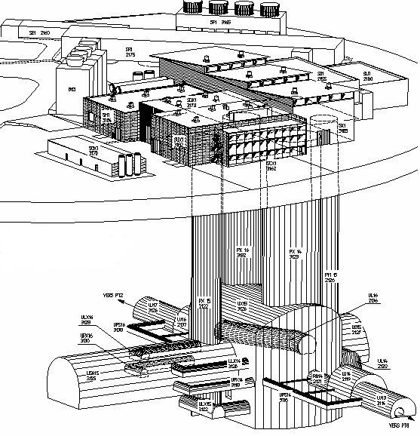
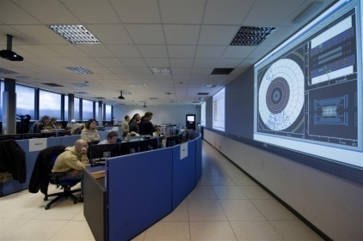
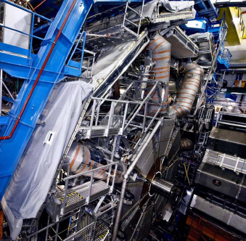
ATLAS Trigger / DAQ Data flow
CERN
computer
centre
SDX1
dual-CPU nodes
~30
~1600
~100
~ 500
Event rate
~ 200 Hz
Local
Storage
SubFarm
Outputs
(SFOs)
Event
Filter
(EF)
Event
Builder
SubFarm
Inputs
(SFIs)
LVL2
farm
Second-
level
trigger
Data
storage
pROS
SDX1
DataFlow
Manager
Network
switches
pROS
stores
LVL2
output
stores
LVL2
output
Network switches
LVL2
Super-
visor
Event data requests
Delete commands
Gigabit Ethernet
Event data
pulled:
partial events
@ ≤ 100 kHz,
full events
@ ~ 3 kHz
Requested event data
USA15
Regions Of Interest
USA15
Data of events accepted
by first-level trigger
~150
PCs
1600
Read-
Out
Links
UX15
VME
Dedicated links
Read-Out
Subsystems
(ROSs)
Read-
Out
Drivers
(RODs)
ATLAS
detector
RoI
Builder
First-
level
trigger
UX15
Timing Trigger Control (TTC)
Event data pushed @ ≤ 100 kHz,
1600 fragments of ~ 1 kByte each

Slide 20
DAQ commissioning
DAQ/data flow system implemented and running
Only a fraction of CPUs installed (∼35%) in 2008
  Recent result, overnight run with 10³¹ menu (800kB event*)
    Data preloaded in 136 ROS
    4 L2SV - 12 L2PU racks - 94 SFIs - 10 EF racks
  Measured
    Lvl2 rate : 60 kHz
      limited by RoI request rate to ROS (50% of LVL1)
      Max expected at high luminosity is 20 kHz (20% of LVL1)
    EB rate : 4.2kHz (LVL2 driven)
    Aggregate effective EB bandwidth 3.3GB/s
  * Event size. Expected : 1.6 MB - normally today : 3 MB (LAr 5 samples for all cells in a cluster)
  1st-beam “splashes” : 7 MB - max seen : 13 MB (LAr 32 samples)

Slide 21
Commissioning of computing model
FDR I and II (Full Dress Rehearsals)
realistic test of the computing model, from online (SFO) to analysis at Tier-2's
all major steps included
exercise the full & final software infrastructure (CondDB, TAGDB, trigger configuration, simulation, etc)
implement the calibration/alignment model
and data quality assessment
provide samples of mixed events which look as much like data as possible for emulations of early analyses
focused on two “FDR run weeks”, each emulating a few fills of data
  FDR-1, simulating data with L∼10³¹ cm⁻²s⁻¹
    Feb 08, Express and bulk reconstruction, data export to Tier-1s and Tier-2s
  FDR-2, simulating data with L∼10³² cm⁻²s⁻¹
    June 08, Including calibration and alignment operation, second express stream, derived-physics-data

Slide 22
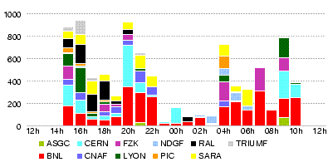
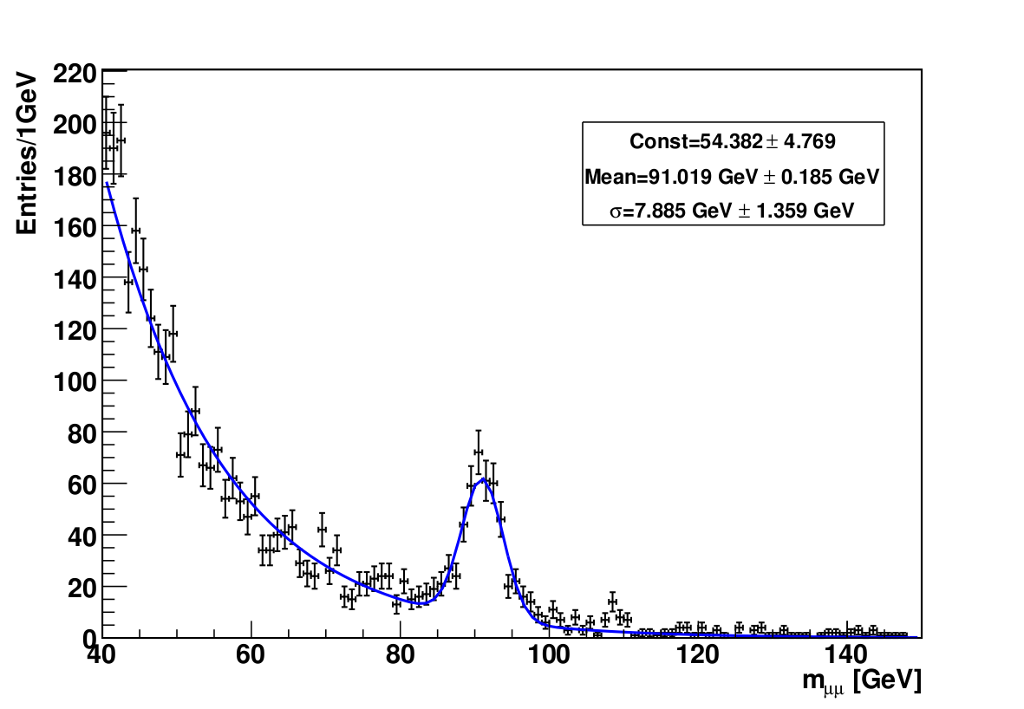
FDR II
Data rate (MB/s)
RAW data export to all ten
Tier-1 sites (18h data in 19h)
Example dimuon mass plot
made from Tier-0 DPD
(5 days after data “taken”)
In summary, chain works, although many details require more work.

Slide 23
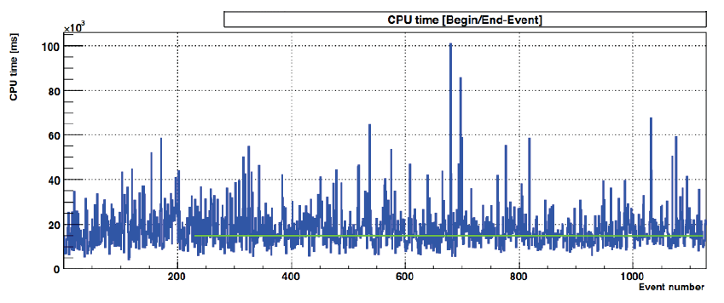
Memory and CPU for event processing
Memory < 2 GB (=2 GB when triggers are run for simulated data)
CPU
  16 kSI2k sec (FDR2b) (ESD, AOD,DPD and monitoring)(*)
  20% due to DPD creation (to improve) ; additional 10% overhead
  Spikes with pile-up for 10³³ luminosity
(*) Acronyms: EventSummaryData(output of reconstruction), AnalysisObjectData(selected output for analysis, DerivedPhysicsDatasets (further selected events/selected information)

Slide 24
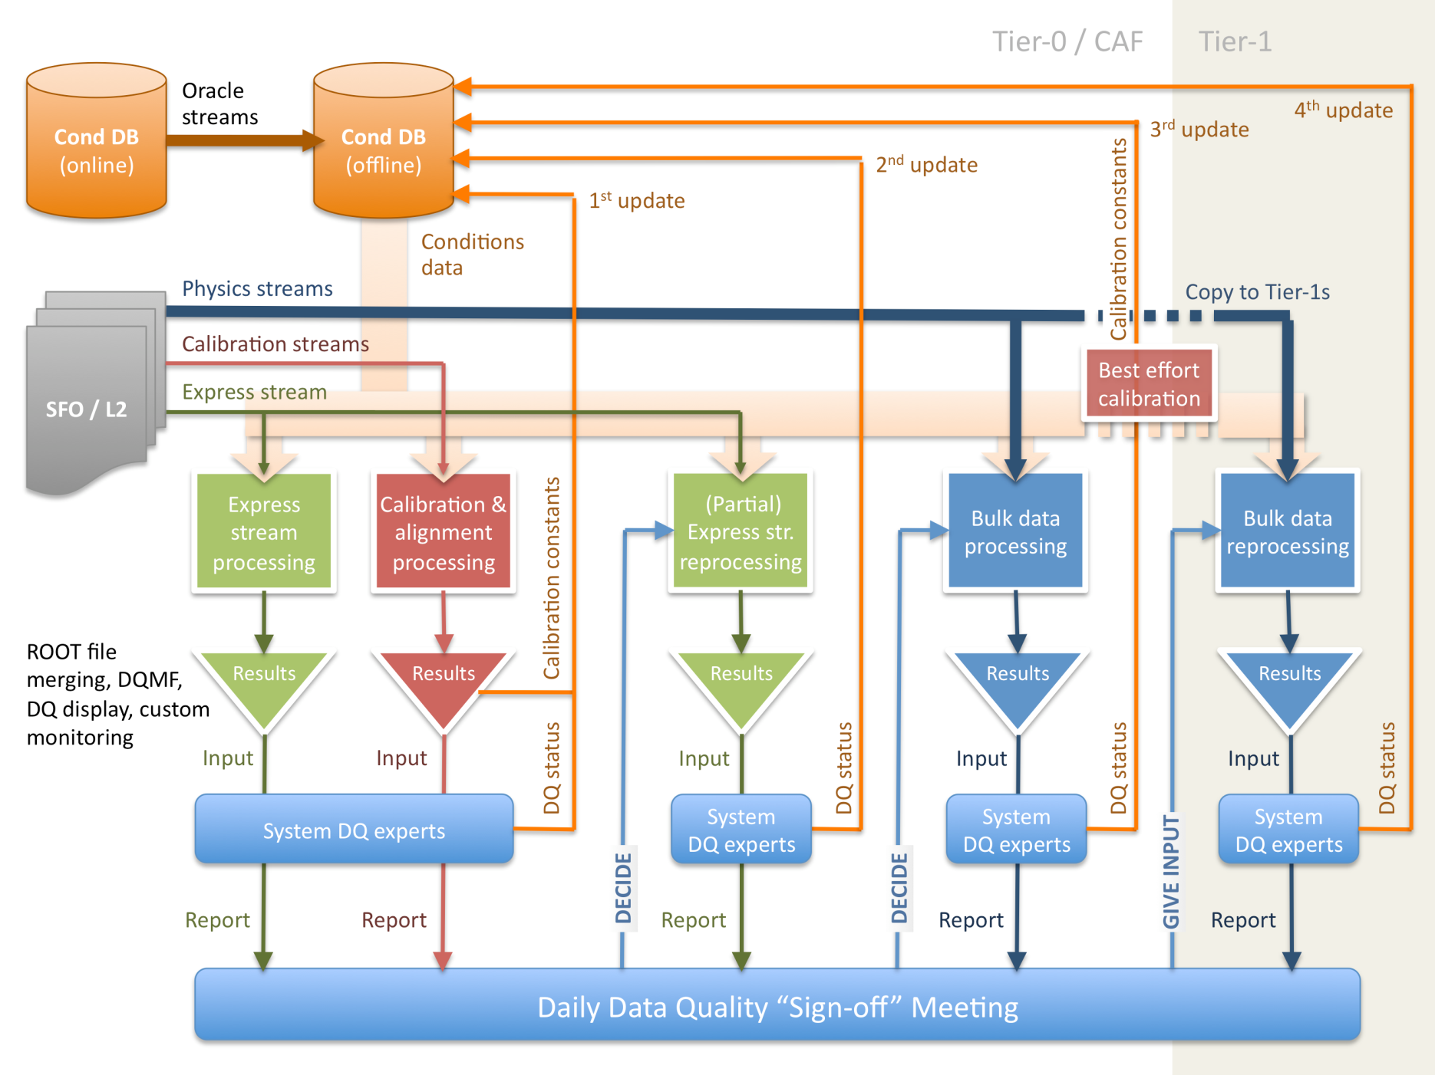
Production and calibration streams
∼18 h
∼30 h

Slide 25
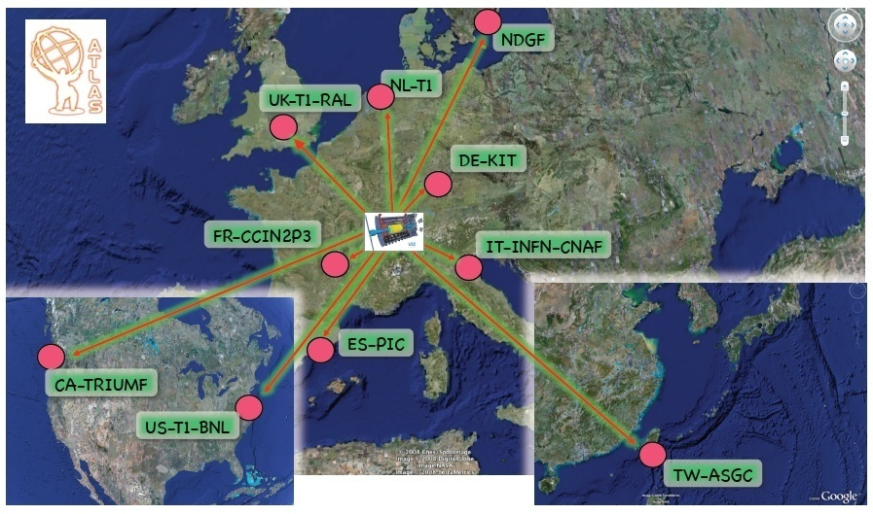
wLCG Grid: Tier-0 and the 10 ATLAS Tier-1s

Slide 26
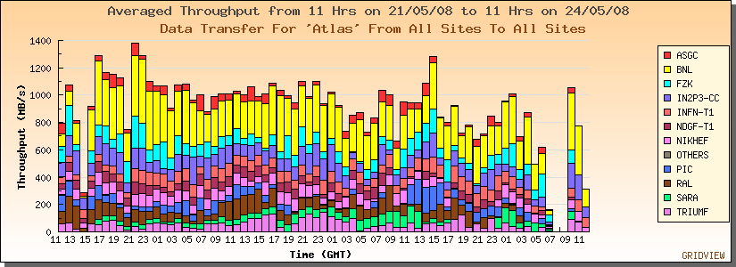
Common Computing Readiness Challenge CCRC Phase 2
Data transfer Tier-0 ⇒ Tiers-1

Slide 27
Preparation of physics studies
ATLAS has recently completed a new set of physics studies, the CSC Notes (CSC=computer system commissioning) based on up-to-date detector description and tools for reconstruction and analysis.
Focus on physics searches achievable with integrated luminosities in the range of ∼ 10 − 100 pb⁻¹.
Chapters cover performance studies of trigger, ID, Muon system, b-tagging, electron/photon, jets/missing E_{T}, and physics studies in the areas of SM, b physics, top, Higgs, SUSY, exotics.
This effort will be published altogether as :
  Expected performance of the ATLAS experiment, detector, trigger and physics, CERN-OPEN-2008-020 (and available on arXiv)

Slide 28
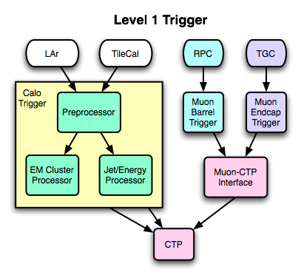
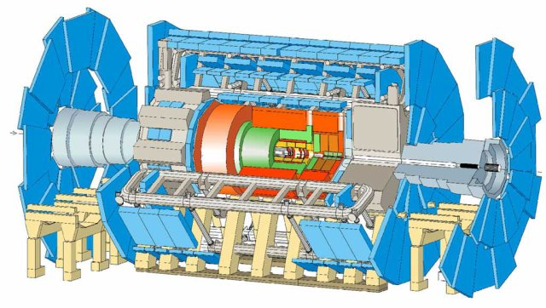
Detector and trigger for first LHC beams
ATLAS was “on” on Sep. 10, although many components operated with reduced HV (e.g.: SCT/barrel at very low bias), Pixel was off (safety and late commissioning), CSC were off (late commissioning or read-out), the luminosity detector LUCID was on and saw the beam. The three toroid systems were on.
Level-1 triggers had been set-up using cosmic rays.
In addition, we had ready a beam-pick-up trigger (BPTX), and a dedicated scintillator hodoscope trigger (MBTS), from a device installed against the front face of the end-cap calorimeters.
Beam pickups
Minimum-bias (MBTS)
LUCID, BCM, etc
tertiary
collimators
140 m
BPTX
175 m

Slide 29
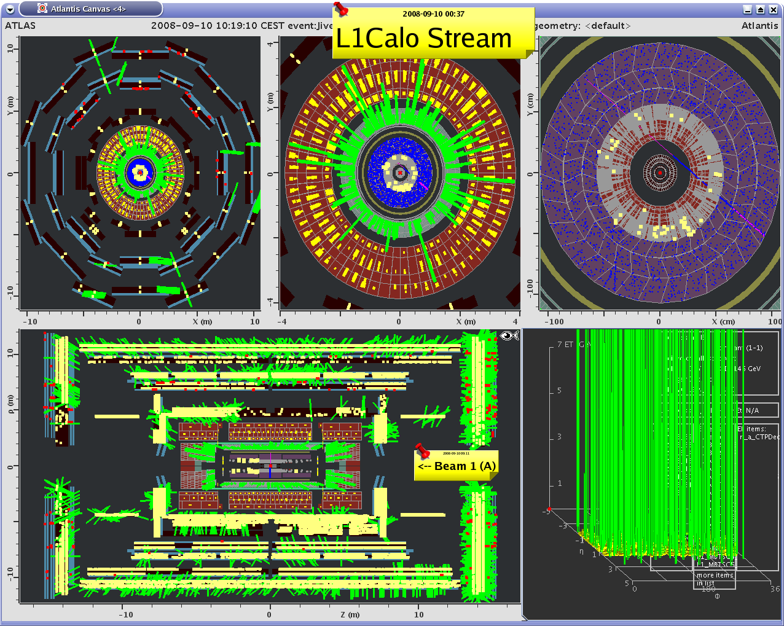
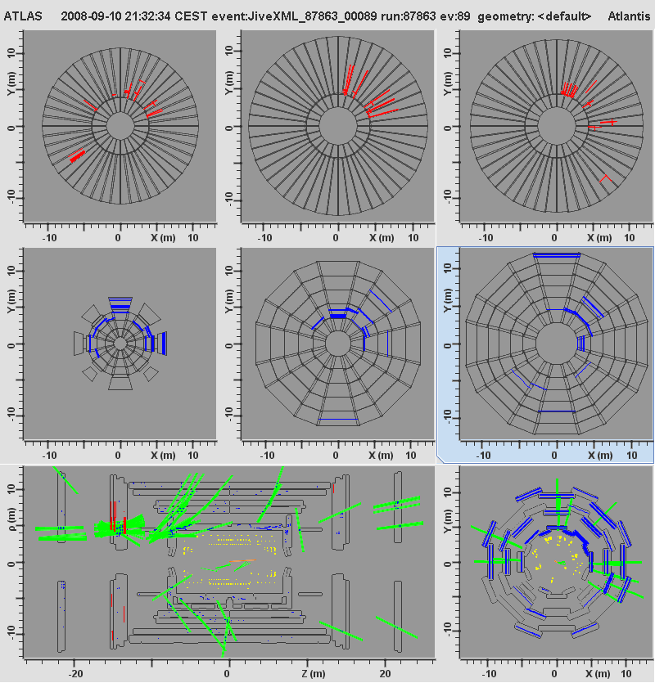
First beams from LHC on Sept. 10 - 12
A more readable event collected later (a “halo” event, with the beam passing through the experimental area)
The first event recorded by ATLAS in the morning (a “splash” event, with the beam substantially dumped on collimators)

Slide 30
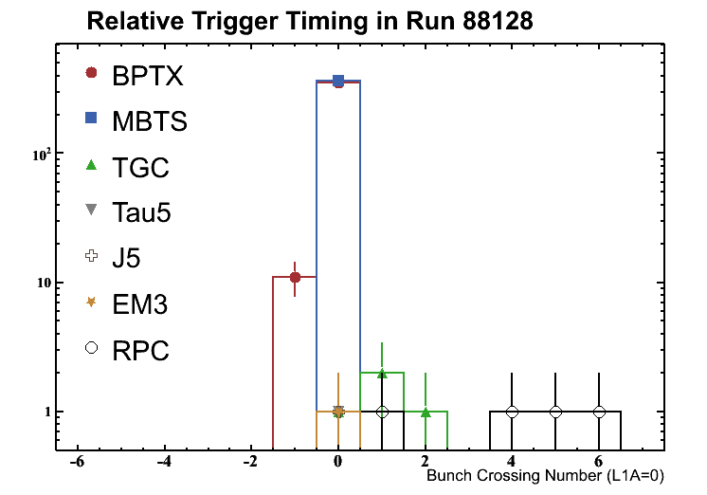
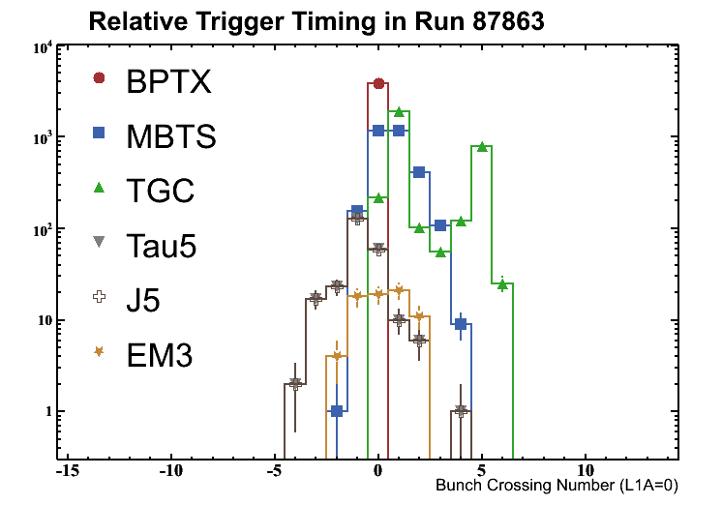
Timing of Level-1 triggers
Morning:
MPTX is the time reference. All other triggers affected by time-of-flight effects (most visible for TGC wheels – one was receiving beam from the “wrong direction”)
Afternoon:
fewer events, cleaner situation, time offsets better defined.

Slide 31


Bunch crossing units
+2
+1
0
-1
-2
Splash events: Calorimeter trigger-towers timing vs. MPTX time:
  Some effects are instrumental,
  but time-of-flight trend due to beam is clearly visible
Tile-Cal timing for splash events:
  Trend within modules entirely due to time-of-flight for splash events

Slide 32

TRT/Barrel-A timing from splash events
Halo event: tracks in TRT/end-caps projected on cylindrical (unrolled) surface, tracks in TRT/barrel projected on plane z=0

Slide 33
Conclusion
After the impressive progress in installation and commissioning of the different subsystems in previous years, 2008 has seen a very significant progress in the overall commissioning of the detector altogether, and the ability of data handling, processing and analysis.
Few hardware items remain to be integrated, and several software procedures have been tested successfully.
The exercise on September 10th found us ready, and we are looking forward to collecting LHC data.

Slide 34
Additional ATLAS presentations at this workshop
Nicoletta Garelli, Commissioning of the Pixel detector
Benjamin Trocme, Commissioning and performance of the LAr calorimeter
Danilo Banfi, Electron and photon reconstruction and identification
Pawel Bruckman de Renstrom, Alignment of the ID
Jose Enrique Garcia, Commissioning of the SCT
Paul Dervan, SCT upgrade for SuperLHC
Enrico Giulio Villani, SCT upgrade for SuperLHC
Andrea Bocci, Commissioning of the TRT
Zachary Marshall, ATLAS simulation software
Christian Schmitt, Commissioning of reconstruction software
Elena Solfaroli Camillocci, Data quality assessment in MDT calibration
Wainer Vandelli, Readiness of Trigger and DAQ
Jiri Masik, Trigger system in first collisions

